Slide 1

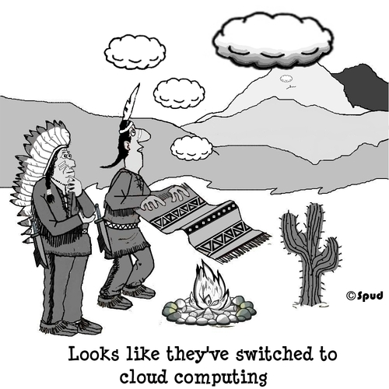

Cloud Computing
Modern Topics in IT(MTIT)
4th Year – Semester 1
By Isuru Jayakantha

Slide 2

Cloud Computing
Cloud computing is a model for enabling convenient, on-demand network access to a shared pool of configurable computing resources (e.g., networks, servers, storage, applications, and services)
It can be rapidly provisioned and released with minimal management effort.
It provides high level abstraction of computation and storage model.
It has some essential characteristics, service models, and deployment models.

Slide 3
Basic Concepts
There are certain services and models working behind the scene making the cloud computing feasible and accessible to end users. Following are the working models for cloud computing:
Service Models
Deployment Models

Slide 4
Service Models
Cloud Software as a Service (SaaS):
The capability provided to the consumer is to use the provider’s applications running on a cloud infrastructure.
The applications are accessible from various client devices such as a web browser
(e.g., web-based email)
The consumer does not manage or control the underlying cloud infrastructure including network, servers, operating systems, storage.
Examples: Caspio, Google Apps, Salesforce, Nivio, Learn.com.

Slide 5
Cloud Platform as a Service (PaaS):
The capability provided to the consumer is to deploy onto the cloud infrastructure consumer-created or acquired applications created using programming languages and tools supported by the provider.
The consumer does not manage or control the underlying cloud infrastructure.
Consumer has control over the deployed applications and possibly application hosting environment configurations.
Examples: Windows Azure, Google App Engine.

Slide 6
Cloud Infrastructure as a Service (IaaS):
The capability provided to the consumer is to provision processing, storage, networks, and other fundamental computing resources.
The consumer is able to deploy and run arbitrary software, which can include operating systems and applications.
The consumer does not manage or control the underlying cloud infrastructure but has control over operating systems, storage, deployed applications, and possibly limited control of select networking components (e.g., host firewalls).
Examples: Amazon EC2, Go-Grid, Rackspace Cloud Servers, Relia Cloud.

Slide 7
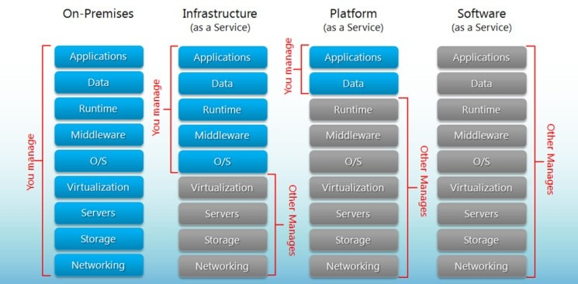

Slide 8
Deployment Models
Deployment models define the type of access to the cloud, i.e., how the cloud is located? Cloud can have any of the four types of access: Public, Private, Hybrid and Community.
Private Cloud:
The cloud is operated solely for an organization. It may be managed by the organization or a third party and may exist on premise or off premise.

Slide 9
Community Cloud:
The cloud infrastructure is shared by several organizations and supports a specific community that has shared concerns.
It may be managed by the organizations or a third party and may exist on premise or off premise.
Public Cloud:
The cloud infrastructure is made available to the general public or a large industry group and it is owned by an organization selling cloud services.

Slide 10
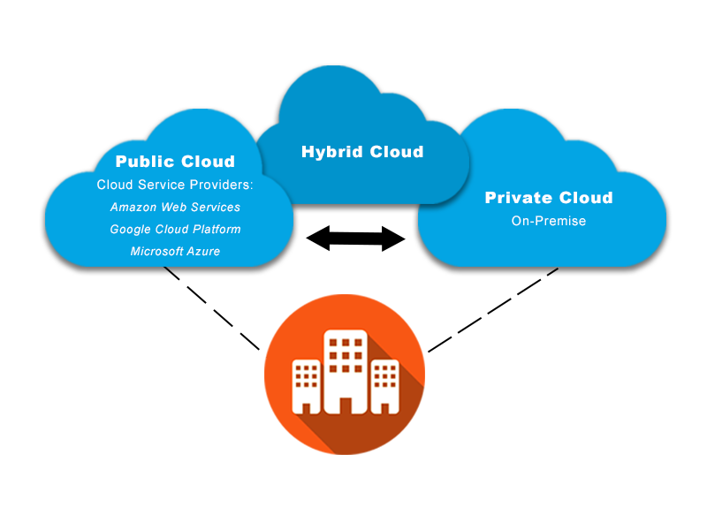
Hybrid cloud:
The cloud infrastructure is a composition of two or more clouds
(private, community, or public).

Slide 11
Advantages of Cloud Computing
Cloud computing do not need high quality equipment for user, and it is very easy to use.
Provides dependable and secure data storage center.
Reduce run time and response time.
Cloud is a large resource pool that you can buy on demand service.
Scale of cloud can extend dynamically providing nearly infinite possibility for users to use internet.

Slide 12
Cloud computing with AWS
Amazon Web Services (AWS) is the world’s most comprehensive and broadly adopted cloud platform, offering over 175 fully featured services from data centers globally.
Millions of customers - including the fastest-growing startups, largest enterprises, and leading government agencies - are using AWS to lower costs, become more agile, and innovate faster.

Slide 13
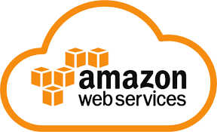
History of AWS
2002- AWS services launched
2006- Launched its cloud products
2012- Holds first customer event
2015- Reveals revenues achieved of $4.6 billion
2016- Surpassed $10 billon revenue target
2016- Release snowball and snowmobile
2019- Offers nearly 100 cloud services
2020 - AWS comprised more than 212 services

Slide 14
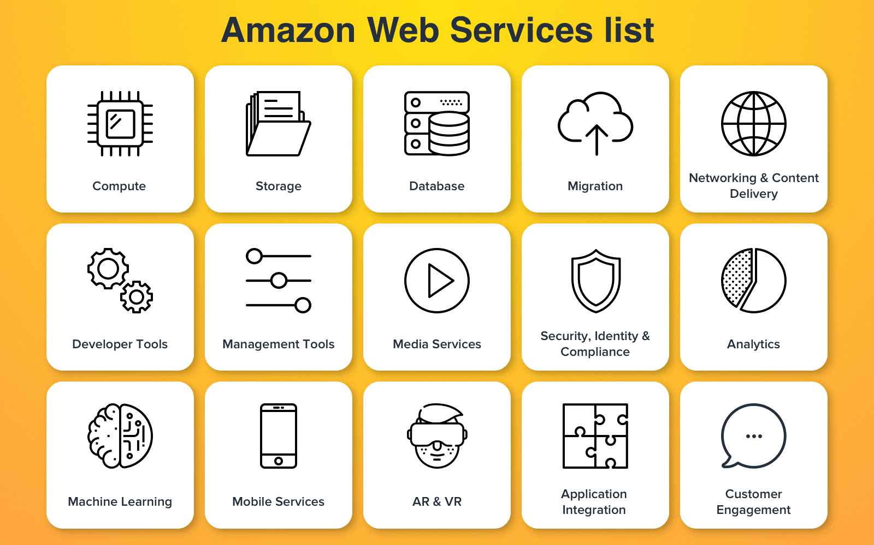
Important AWS Services

Slide 15
AWS Compute Services
EC2(Elastic Compute Cloud) - EC2 is a virtual machine in the cloud on which you have OS level control. You can run this cloud server whenever you want.
LightSail -This cloud computing tool automatically deploys and manages the computer, storage, and networking capabilities required to run your applications.
Amazon Elastic Kubernetes Service (EKS : Elastic Container Service for Kubernetes) - The tool allows you to Kubernetes on Amazon cloud environment without installation.
AWS Lambda -This AWS service allows you to run functions in the cloud. The tool is a big cost saver for you as you to pay only when your functions execute.
Elastic Beanstalk - Easy-to-use service for deploying and scaling web applications and services developed with Java, .NET, PHP, Node.js, Python, Ruby, Go, and Docker.

Slide 16
Migration
Migration services used to transfer data physically between your datacenter and AWS.
DMS (Database Migration Service) -DMS service can be used to migrate on-site databases to AWS. It helps you to migrate from one type of database to another — for example, Oracle to MySQL.
SMS (Server Migration Service) - SMS migration services allows you to migrate on-site servers to AWS easily and quickly.
Snowball - Snowball is a small application which allows you to transfer terabytes of data inside and outside of AWS environment.

Slide 17
Storage
Amazon Glacier- It is an extremely low-cost storage service. It offers secure and fast storage for data archiving and backup.
Amazon Elastic Block Store (EBS)- It provides block-level storage to use with Amazon EC2 instances. Amazon Elastic Block Store volumes are network-attached and remain independent from the life of an instance.
AWS Storage Gateway- This AWS service is connecting on-premises software applications with cloud-based storage. It offers secure integration between the company's on-premises and AWS's storage infrastructure.

Slide 18
Security Services
IAM (Identity and Access Management) - IAM is a secure cloud security service which helps you to manage users, assign policies, form groups to manage multiple users.
Inspector - It is an agent that you can install on your virtual machines, which reports any security vulnerabilities.
Certificate Manager - The service offers free SSL certificates for your domains that are managed by Route53.
WAF (Web Application Firewall) - WAF security service offers application-level protection and allows you to block SQL injection and helps you to block cross-site scripting attacks.

Slide 19
Cloud Directory - This service allows you to create flexible, cloud-native directories for managing hierarchies of data along multiple dimensions.
KMS (Key Management Service) - It is a managed service. This security service helps you to create and control the encryption keys which allows you to encrypt your data.
Organizations - You can create groups of AWS accounts using this service to manages security and automation settings.
Shield - Shield is managed DDoS (Distributed Denial of Service protection service). It offers safeguards against web applications running on AWS.
Macie - It offers a data visibility security service which helps classify and protect your sensitive critical content.
GuardDuty - It offers threat detection to protect your AWS accounts and workloads.

Slide 20
Database Services
Amazon RDS - This Database AWS service is easy to set up, operate, and scale a relational database in the cloud.
Amazon DynamoDB - It is a fast, fully managed NoSQL database service. It is a simple service which allow cost-effective storage and retrieval of data. It also allows you to serve any level of request traffic.
Amazon ElastiCache - It is a web service which makes it easy to deploy, operate, and scale an in-memory cache in the cloud.
Neptune - It is a fast, reliable and scalable graph database service.
Amazon RedShift - It is Amazon's data warehousing solution which you can use to perform complex OLAP queries.

Slide 21
Analytics
Athena - This analytics service allows perm SQL queries on your S3 bucket to find files.
CloudSearch - You should use this AWS service to create a fully managed search engine for your website.
ElasticSearch - It is similar to CloudSearch. However, it offers more features like application monitoring.
Kinesis - This AWS analytics service helps you to stream and analyzing real-time data at massive scale.
QuickSight - It is a business analytics tool. It helps you to create visualizations in a dashboard for data in Amazon Web Services. For example, S3, DynamoDB, etc.
EMR (Elastic Map Reduce) - This AWS analytics service mainly used for big data processing like Spark, Splunk, Hadoop, etc.
Data Pipeline - Allows you to move data from one place to another. For example from DynamoDB to S3

Slide 22
Management Services
CloudWatch - Cloud watch helps you to monitor AWS environments like EC2, RDS instances, and CPU utilization. It also triggers alarms depends on various metrics.
CloudFormation - It is a way of turning infrastructure into the cloud. You can use templates for providing a whole production environment in minutes.
CloudTrail - It offers an easy method of auditing AWS resources. It helps you to log all changes.
OpsWorks - The service allows you to automated Chef/Puppet deployments on AWS environment.
Config - This AWS service monitors your environment. The tool sends alerts about changes when you break certain defined configurations.

Slide 23
Management Services
Service Catalog - This service helps large enterprises to authorize which services user will be used and which won’t.
AWS Auto Scaling - The service allows you to automatically scale your resources up and down based on given CloudWatch metrics.
Systems Manager - This AWS service allows you to group your resources. It allows you to identify issues and act on them.
Managed Services - It offers management of your AWS infrastructure which allows you to focus on your applications.

Slide 24
Internet of Things
IoT Core - It is a managed cloud AWS service. The service allows connected devices like cars, light bulbs, sensor grids, to securely interact with cloud applications and other devices.
IoT Device Management - It allows you to manage your IoT devices at any scale.
IoT Analytics - This AWS IOT service is helpful to perform analysis on data collected by your IoT devices.
Amazon FreeRTOS - This real-time operating system for microcontrollers helps you to connect IoT devices in the local server or into the cloud.

Slide 25
Application Services
Step Functions - It is a way of visualizing what's going inside your application and what different microservices it is using.
SWF (Simple Workflow Service) - The service helps you to coordinate both automated tasks and human-led tasks.
SNS (Simple Notification Service) - You can use this service to send you notifications in the form of email and SMS based on given AWS services.
SQS (Simple Queue Service) - Use this AWS service to decouple your applications. It is a pull-based service.
Elastic Transcoder - This AWS service tool helps you to changes a video's format and resolution to support various devices like tablets, smartphones of different resolutions.

Slide 26
Deployment and Management
AWS CloudTrail - The services records AWS API calls and send backlog files to you.
Amazon CloudWatch - The tools monitor AWS resources like Amazon EC2 and Amazon RDS DB Instances. It also allows you to monitor custom metrics created by user's applications and services.
AWS CloudHSM - This AWS service helps you meet corporate, regulatory, and contractual, compliance requirements for maintaining data security by using the Hardware Security Module(HSM) appliances inside the AWS environment.

Slide 27
Developer Tools
CodeStar - Codestar is a cloud-based service for creating, managing, and working with various software development projects on AWS.
CodeCommit - It is AWS's version control service which allows you to store your code and other assets privately in the cloud.
CodeBuild - This Amazon developer service help you to automates the process of building and compiling your code.
CodeDeploy -It is a way of deploying your code in EC2 instances automatically.
CodePipeline - It helps you create a deployment pipeline like testing, building, testing, authentication, deployment on development and production environments.
Cloud9 - It is an Integrated Development Environment for writing, running, and debugging code in the cloud.

Slide 28
Mobile Services
Mobile Hub - Allows you to add, configure and design features for mobile apps.
Cognito - Allows users to signup using his or her social identity.
Device Farm - Device farm helps you to improve the quality of apps by quickly testing hundreds of mobile devices.
AWS AppSync - It is a fully managed GraphQL service that offers real-time data synchronization and offline programming features.

Slide 29
Business Productivity
Alexa for Business - It empowers your organization with voice, using Alexa. It will help you to Allows you to build custom voice skills for your organization.
Chime - Can be used for online meeting and video conferencing.
WorkDocs - Helps to store documents in the cloud
WorkMail - Allows you to send and receive business emails.

Slide 30
Desktop & App Streaming
Work Spaces - Workspace is a VDI (Virtual Desktop Infrastructure). It allows you to use remote desktops in the cloud.
AppStream - A way of streaming desktop applications to your users in the web browser. For example, using MS Word in Google Chrome.

Slide 31
Artificial Intelligence
Lex - Lex tool helps you to build chatbots quickly.
Polly - It is AWS's text-to-speech service allows you to create audio versions of your notes.
Rekognition - It is AWS's face recognition service. This AWS service helps you to recognize faces and object in images and videos.
SageMaker - Sagemaker allows you to build, train, and deploy machine learning models at any scale.
Transcribe - It is AWS's speech-to-text service that offers high-quality and affordable transcriptions.
Translate - It is a very similar tool to Google Translate which allows you to translate text in one language to another.

Slide 32
AR & VR (Augmented Reality & Virtual Reality)
Sumerian - Sumerian is a set of tool for offering high-quality virtual reality (VR) experiences on the web. The service allows you to create interactive 3D scenes and publish it as a website for users to access.
Customer Engagement
Amazon Connect - Amazon Connect allows you to create your customer care center in the cloud.
Pinpoint - Pinpoint helps you to understand your users and engage with them.
SES (Simple Email Service) - Helps you to send bulk emails to your customers at a relatively cost-effective price.

Slide 33



Game Development
Game Lift - It is a service which is managed by AWS. You can use this service to host dedicated game servers. It allows you to scale seamlessly without taking your game offline.
Amazon Lumberyard – is a free cross-platform game engine developed by Amazon and based on CryEngine.
Game Development
Game Lift - It is a service which is managed by AWS. You can use this service to host dedicated game servers. It allows you to scale seamlessly without taking your game offline.
Amazon Lumberyard – is a free cross-platform game engine developed by Amazon and based on CryEngine.

Slide 34
Applications of AWS services
Web site hosting
Application hosting/SaaS hosting
Media Sharing (Image/ Video)
Mobile and Social Applications
Content delivery and Media Distribution
Storage, backup, and disaster recovery
Development and test environments
Academic Computing
Search Engines
Social Networking

Slide 35


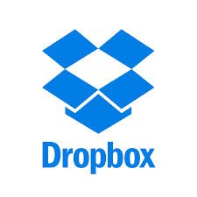



Companies using AWS
Instagram
Zoopla
Smugmug
Pinterest
Netflix
Dropbox
Etsy
Talkbox
Supercell

Slide 36
Advantages of AWS
AWS allows organizations to use the already familiar programming models, operating systems, databases, and architectures.
It is a cost-effective service that allows you to pay only for what you use, without any up-front or long-term commitments.
You will not require to spend money on running and maintaining data centers.
Offers fast deployments.
You can easily add or remove capacity.

Slide 37
Advantages of AWS
You are allowed cloud access quickly with limitless capacity.
Total Cost of Ownership is very low compared to any private/dedicated servers.
Offers Centralized Billing and management
Offers Hybrid Capabilities
Allows you to deploy your application in multiple regions around the world with just a few clicks

Slide 38
Disadvantages of AWS
If you need more immediate or intensive assistance, you'll have to opt for paid support packages.
Amazon Web Services may have some common cloud computing issues when you move to a cloud. For example, downtime, limited control, and backup protection.
AWS sets default limits on resources which differ from region to region. These resources consist of images, volumes, and snapshots.
Hardware-level changes happen to your application which may not offer the best performance and usage of your applications.

Slide 39
Best practices of AWS
You need to design for failure, but nothing will fail.
It's important to decouple all your components before using AWS services.
You need to keep dynamic data closer to compute and static data closer to the user.
It's important to know security and performance tradeoffs.
Pay for computing capacity by the hourly payment method.

Slide 40
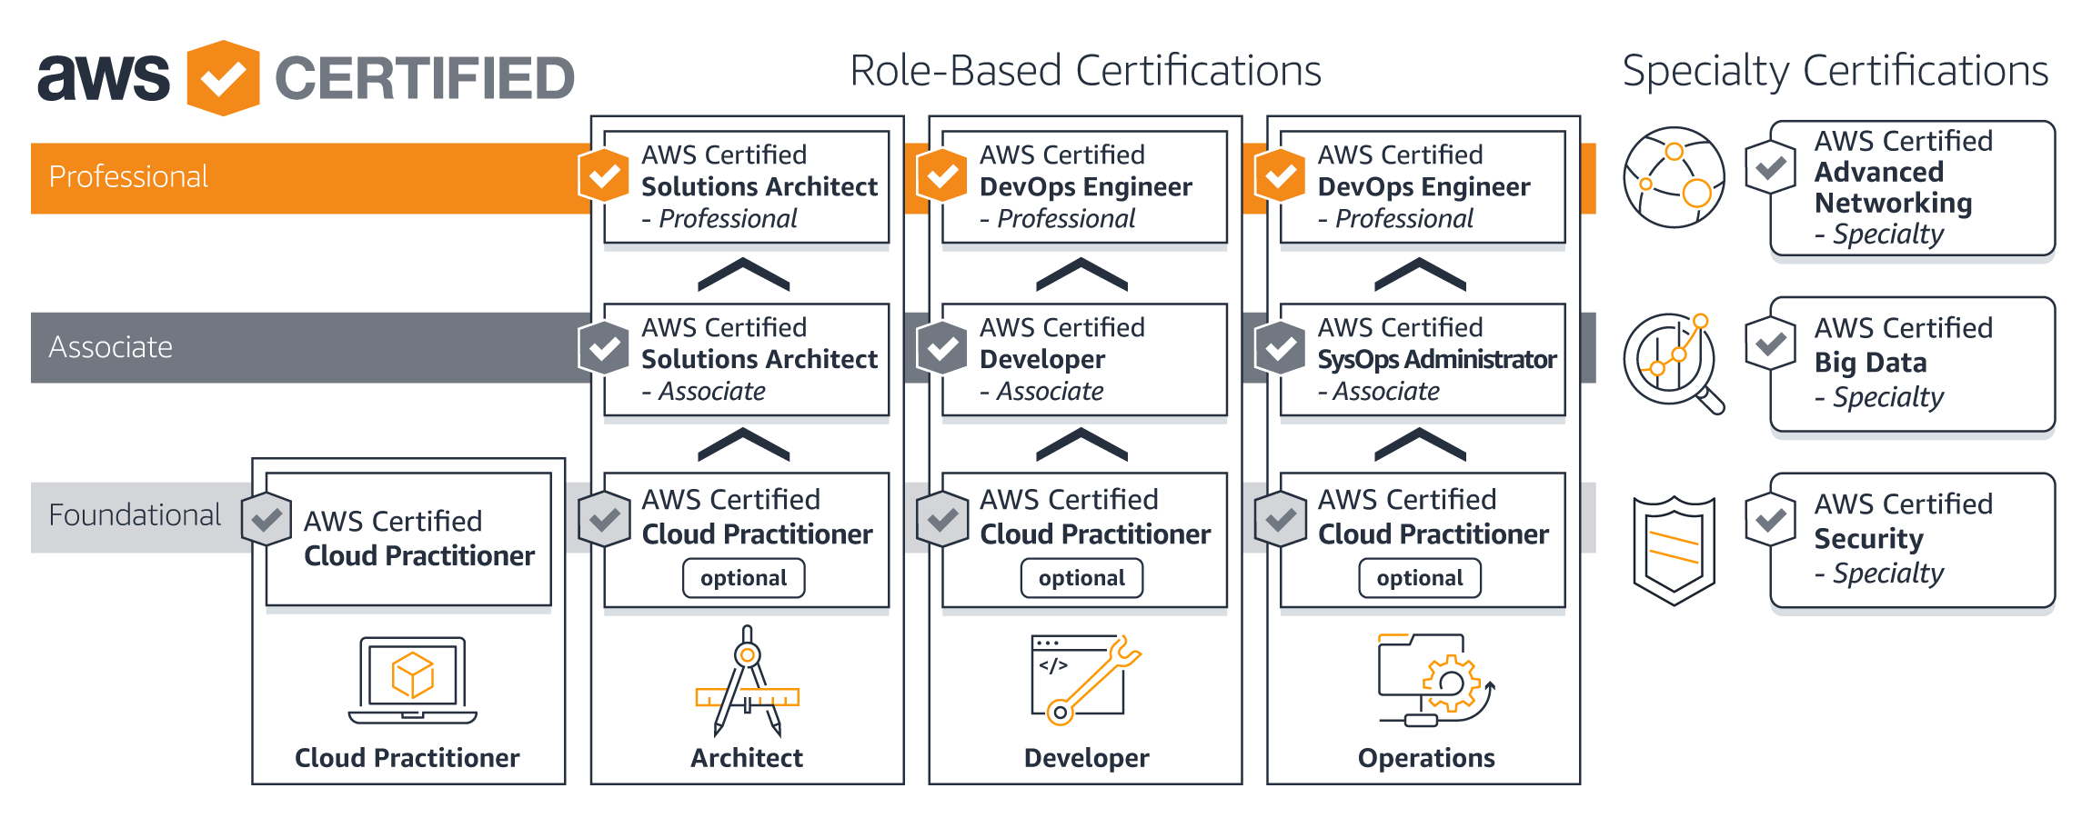
AWS Certifications

Slide 41
References
https://aws.amazon.com/
https://aws.amazon.com/what-is-aws/?nc1=f_cc

